Slide 1
ABSTRACT DESIGN PATTERN
GROUP 12
Trần Anh Kiệt – 18125093
Lưu Quốc Đoàn – 18125005
Nguyễn Trần Quang Duy – 18125048

Slide 2
OUTLINES
01
INTRODUCTION
02
DEFINITION & IMPLEMENTATION
03
CONSEQUENCES
04
SIMILAR PROBLEM
05
QUIZ

Slide 3
I
INTRODUCTION

Slide 4
“Find 'em and kill ‘em” Game
SillyMonster
SillySuperMonster
BadSoldier
SillySoldier
EASY LEVEL
BadMonster
DIEHARD LEVEL
BadSuperMonster

Slide 5
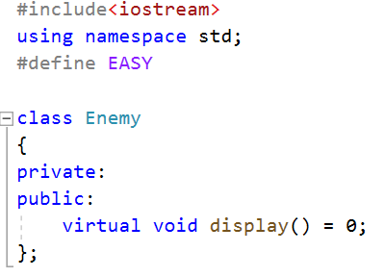

Slide 6
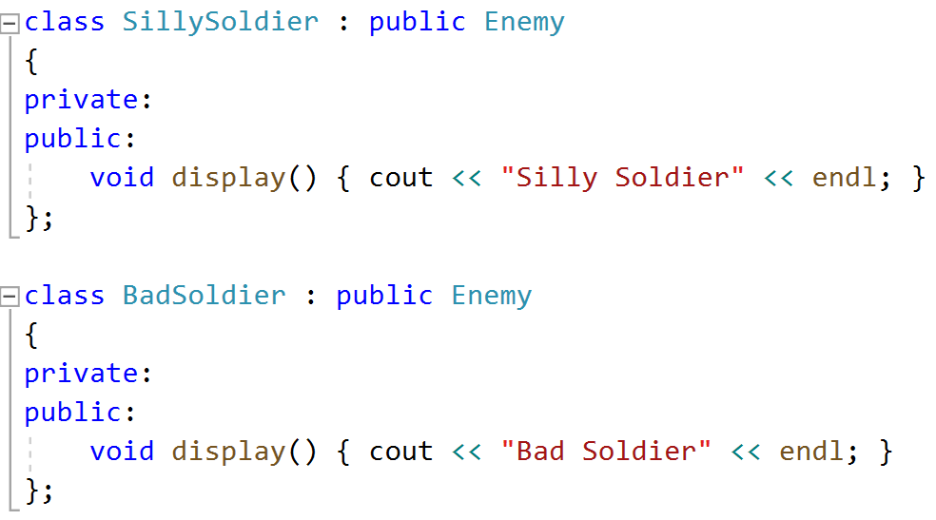

Slide 8
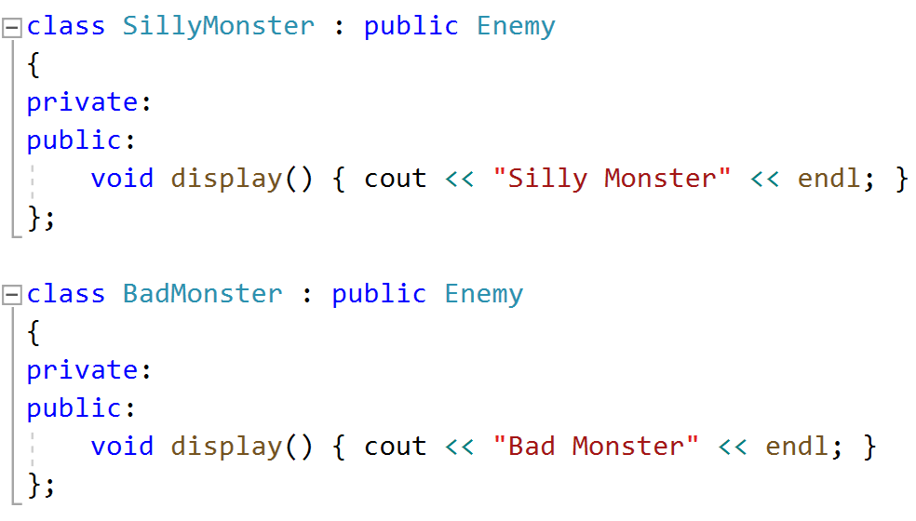

Slide 9
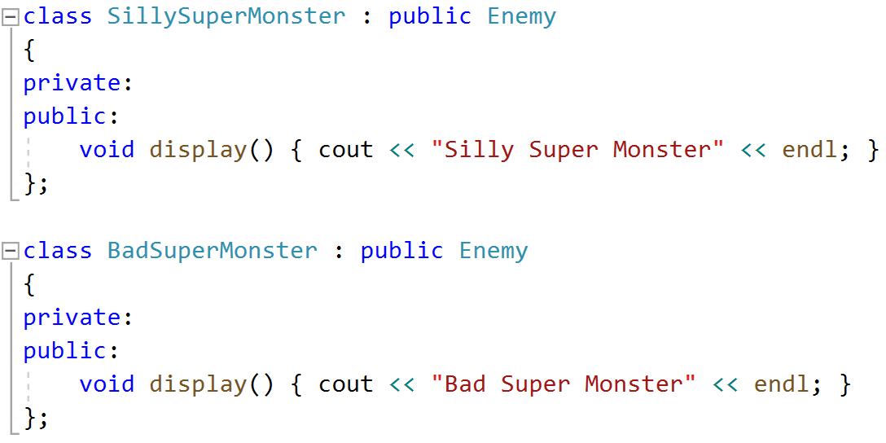

Slide 10
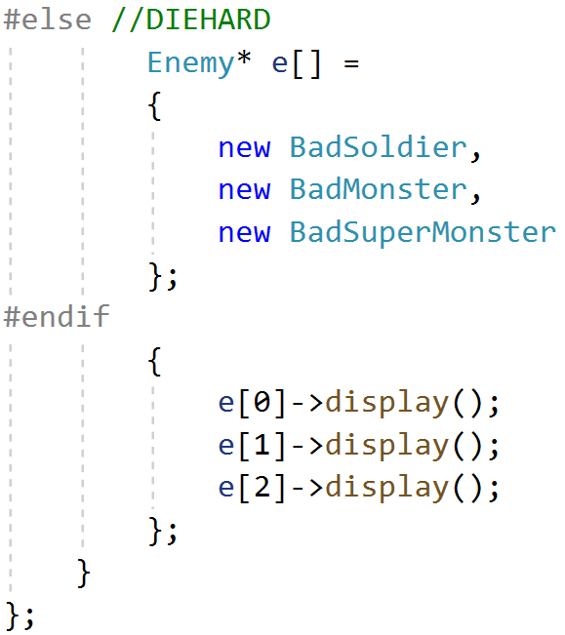
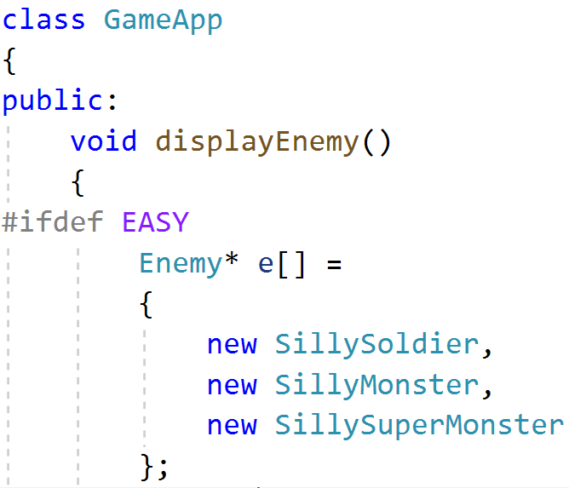

Slide 11
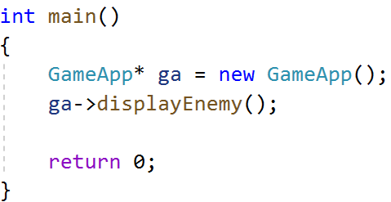
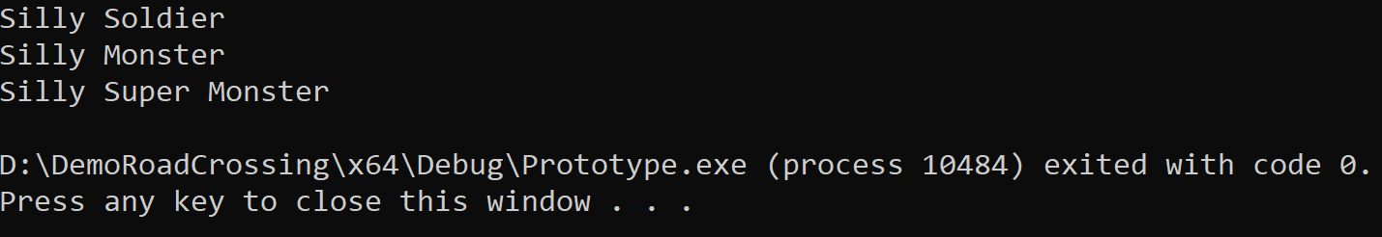

Slide 12
DISADVANTAGES
The GameApp creates "product" objects directly, and must embed all possible permutations in nasty looking code.

Slide 13
II
DEFINITION& IMPLEMENTATION

Slide 14
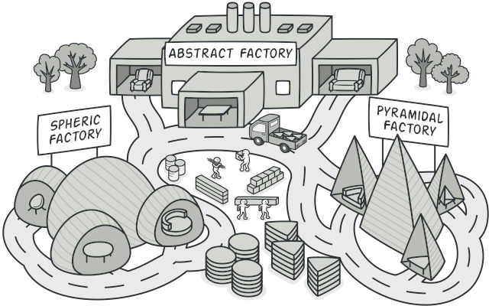
WHAT IS ABSTRACT FACTORY PATTERN?
Abstract Factory is a creational design pattern that lets you produce families of related objects without specifying their concrete classes.

Slide 15
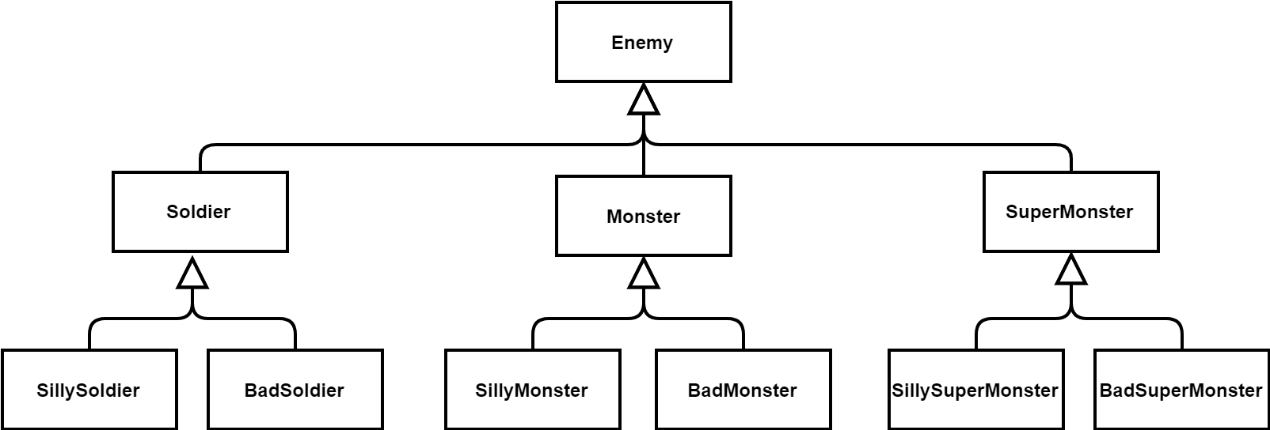
A hierarchy for a game with two levels of difficulty

Slide 16
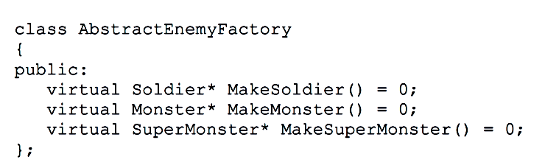
First, gathering the creation functions for all the
game objects into a single interface, as follows

Slide 17
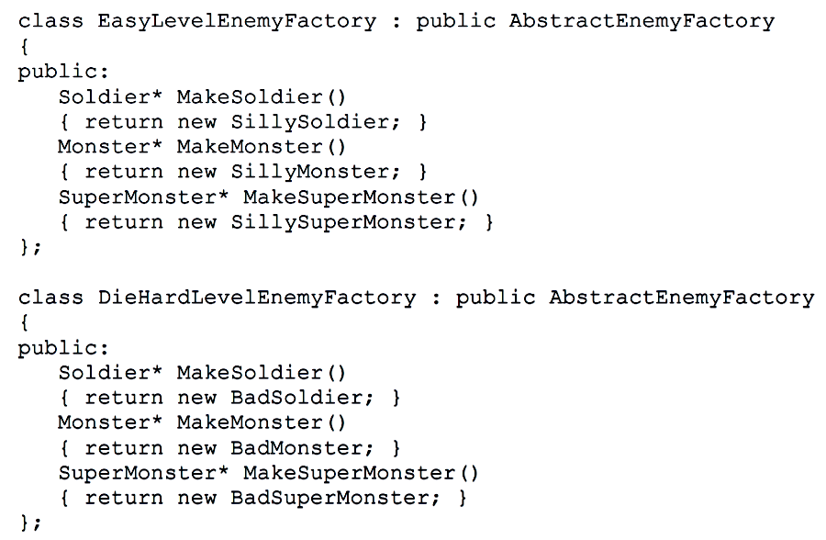
Then, for each play level, implementing a concrete enemy factory that creates enemies as prescribed by the game strategy.

Slide 18
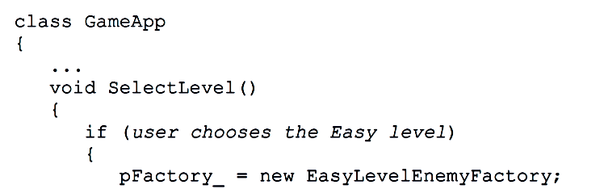
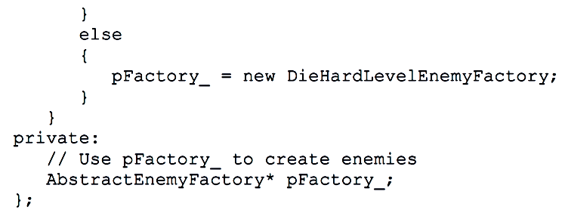
Finally, initializing a pointer to AbstractEnemyFactory with the appropriate concrete class

Slide 19
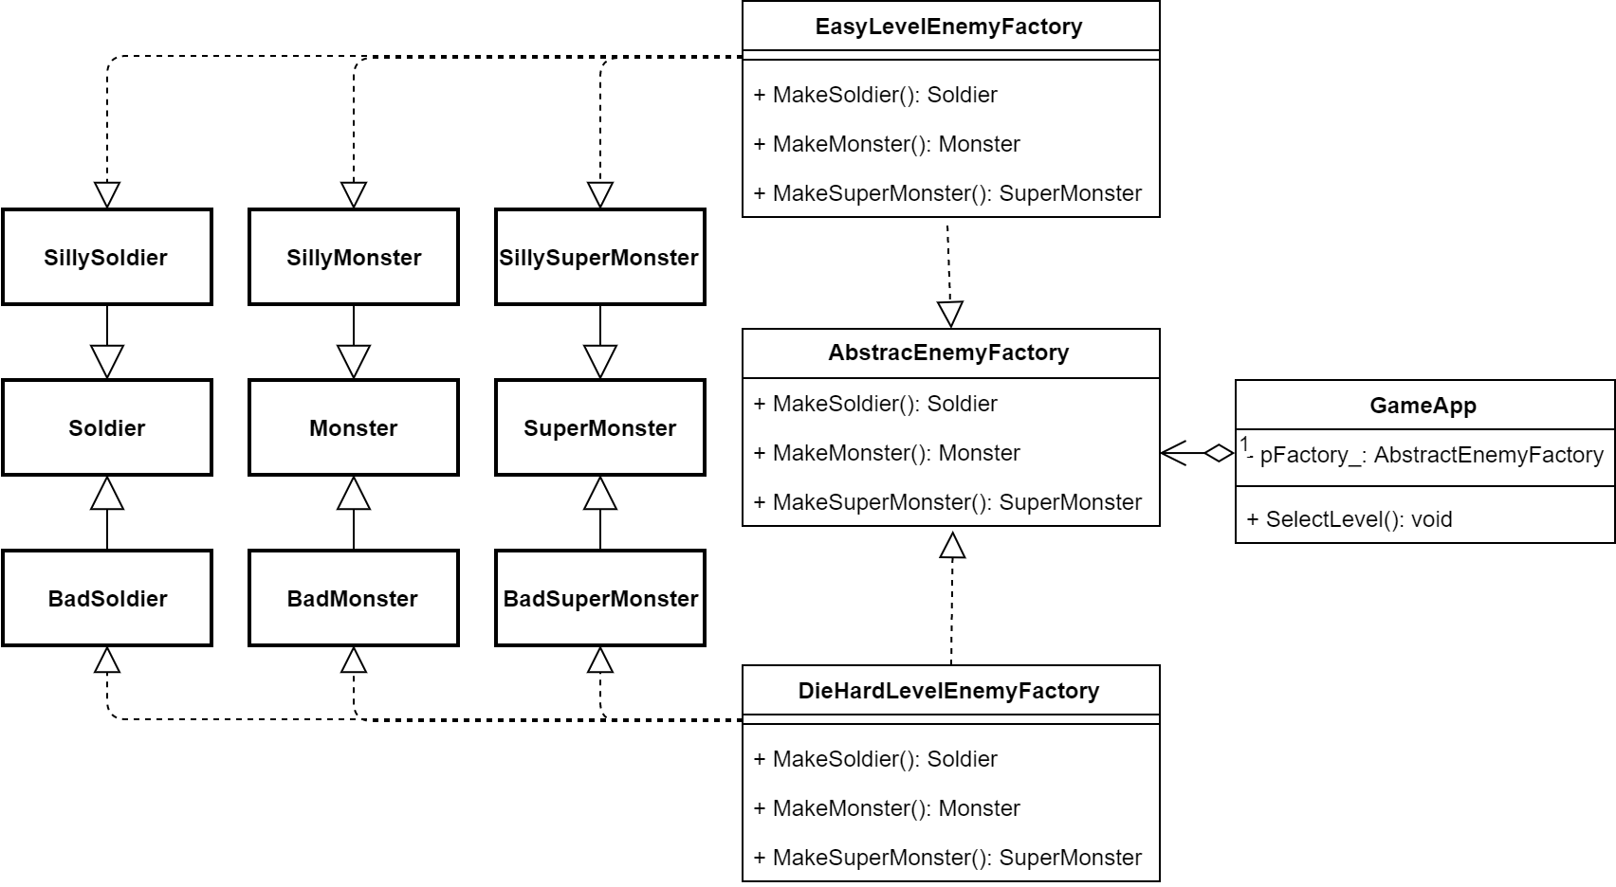

Slide 20
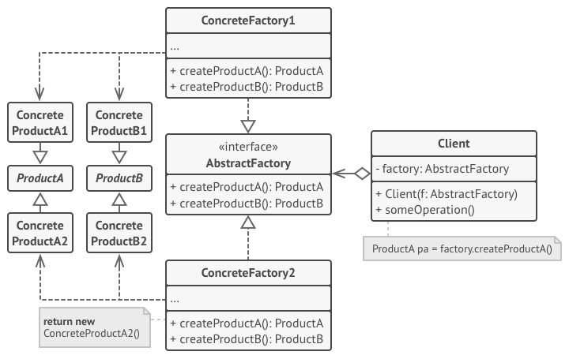
2. Concrete Products are various implementations of abstract products, grouped by variants. Each abstract product must be implemented in all given variants.
3. The Abstract Factory interface declares a set of methods for creating each of the abstract products.
1. Abstract Products declare interfaces for a set of distinct but related products which make up a product family.
4. Concrete Factories implements the operations to create concrete product objects.
5. Clients use only interfaces declared by Abstract Factory and Abstract Product classes
STRUCTURE

Slide 21
APPLICABILITY
Use the Abstract Factory pattern when
A system should be independent of how its products are created, composed, and represented.
A system should be configured with one of multiple families of products.
A family of related product objects is designed to be used together.
You want to provide a class library of products, and you want to reveal just their interfaces, not their implementations.

Slide 22
III
CONSEQUENCES

Slide 23
ADVANTAGES
Isolation of concrete classes
Exchanging Product Families easily
Promoting consistency among products
The Abstract Factory pattern helps you control the classes of objects that an application creates.
The class of a concrete factory appears only once in an application, that is where it’s instantiated. This makes it easy to change the concrete factory an application uses.
When product objects in a family are designed to work together, it’s important that an application use objects from only one family at a time. AbstractFactory makes this easy to enforce.

Slide 24
DISADVANTAGES
Difficult to support new kind of products
Extending abstract factories to produce new kinds of products isn’t easy. That’s because the Abstract Factory interface fixes the set of products that can be created.

Slide 25
IV
SIMILAR PROBLEM

Slide 26
SIMILAR PROBLEM
01
Phone Number Example
02
Look & Feel Example
03
Pizza Factory Example

Slide 27
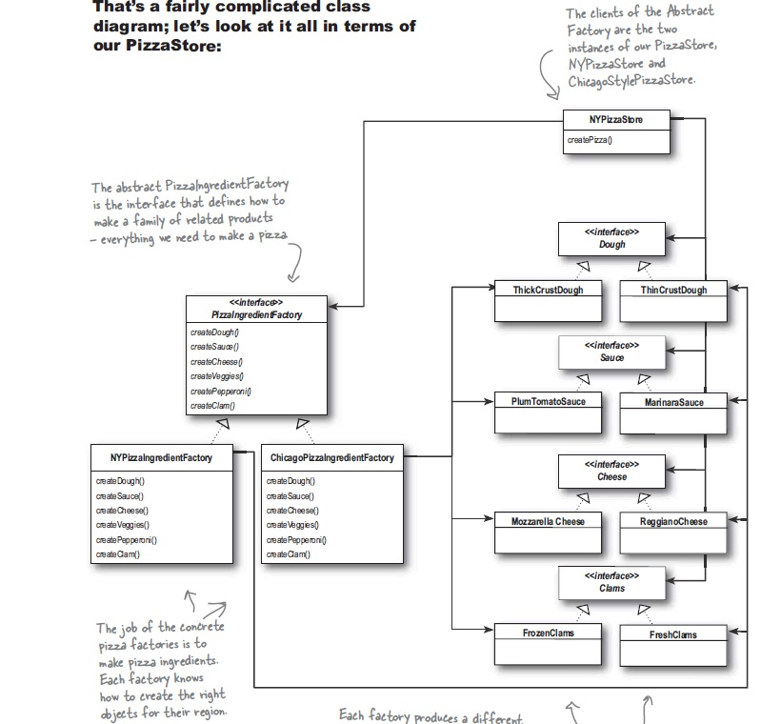

Slide 28
V
QUIZ TIME

Slide 29

KAHOOT

Slide 30

REFERENCES
Design Patterns Elements of Reusable Object-Oriented Software
Produced by KevinZhang
Head First Design Patterns: A Brain-Friendly Guide
https://iq.opengenus.org/abstract-factory-pattern-cpp/

